Slide 1
Google Data Analytics Capstone Project: Cyclistic Case Study
Jesse Richardville
1/5/2023

Slide 2
About Cyclistic
In 2016, Cyclistic launched a successful bike-share offering. Since then, the program has grown to a fleet of 5,824 bicycles that are geo-tracked and locked into a network of 692 stations across Chicago. The bikes can be unlocked from one station and returned to any other station in the system anytime.
Until now, Cyclistic’s marketing strategy relied on building general awareness and appealing to broad consumer segments. One approach that helped make these things possible was the flexibility of its pricing plans: single-ride passes, full-day passes, and annual memberships. Customers who purchase single-ride or full-day passes are referred to as casual riders. Customers who purchase annual memberships are Cyclistic members.
Cyclistic’s finance analysts have concluded that annual members are much more profitable than casual riders. Although the pricing flexibility helps Cyclistic attract more customers, the director of marketing believes that maximizing the number of annual members will be key to future growth. Rather than creating a marketing campaign that targets all-new customers, the director of marketing believes there is a very good chance to convert casual riders into members. She notes that casual riders are already aware of the Cyclistic program and have chosen Cyclistic for their mobility needs.

Slide 3
Case Study Objective:
Design marketing strategies aimed at converting casual riders into annual members based on the following:
Better understand how annual members and casual riders differ
Why would casual riders buy a membership
How digital media could affect Cyclistic marketing tactics
The director of marketing and her team are interested in analyzing the Cyclistic historical bike trip data to identify trends.

Slide 4
Cyclistic Data
The data has been made available by Motivate International Inc. under this license (https://ride.divvybikes.com/data-license-agreement).
Data is complete, original, and open source, directly from the company here (https://divvy-tripdata.s3.amazonaws.com/index.html).
12 months of data from 12/2021 - 11/2022 (last updated on Dec 8th 2021, 02:19:04 pm) has been analyzed.

Slide 5
Cyclistic Rider Options
As of December 2022, Cyclistic offers the following usage options in Chicago, IL:
$3.30/trip for a single 30 minute ride (casual rider)
$15/day for unlimited 3-hour rides in a 24-hour period (casual rider)
$9/month for annual membership of unlimited 45 minute rides (member rider)

Slide 6
Data cleaning and transformation
R Studio Desktop was used to process the data and Power BI was used to visualize the data for presentation
Incomplete and irrelevant data was removed
Trips missing a station name
Test rides
Rides less than 60 seconds and more than 12 hours
The full data cleaning process has been documented in “clean_and_analyze_data” (see appendix)
The 6 Data Analysis steps have been included in the appendix
Ask, Prepare, Process, Analyze, Share, Act

Slide 7
Notable insights/findings:
4,332,097 total rides were taken between 12/2021 - 11/2022
Members took 60% of all rides
Between 80,000 – 630,000 rides were taken monthly, with summer months being the most popular (May – September)
Wednesday is the most popular day for members and Saturday is the most popular day for casual riders
Saturday is the most popular day overall (16.1% of all rides taken) and Monday is the least popular day overall (13.4% of all rides taken)
Casual riders take longer rides by time (23.3 min avg ride), members take shorter rides (12.5 min avg ride) and are more consistent users

Slide 8
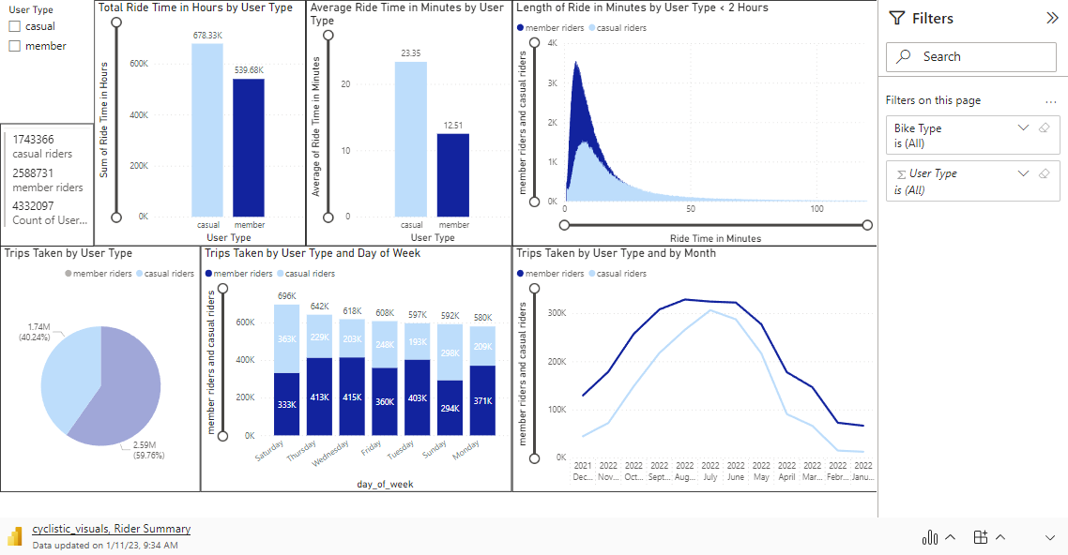
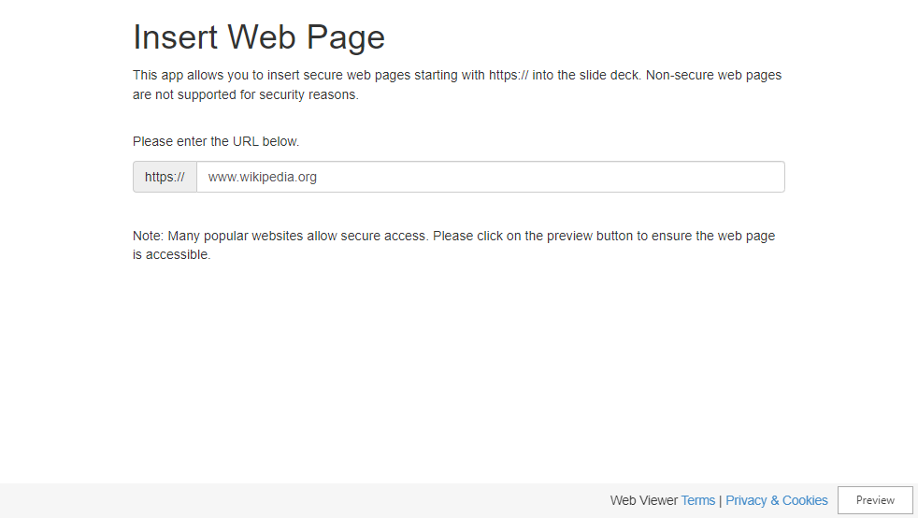
Jesse Richardville
1/5/2023

Slide 9

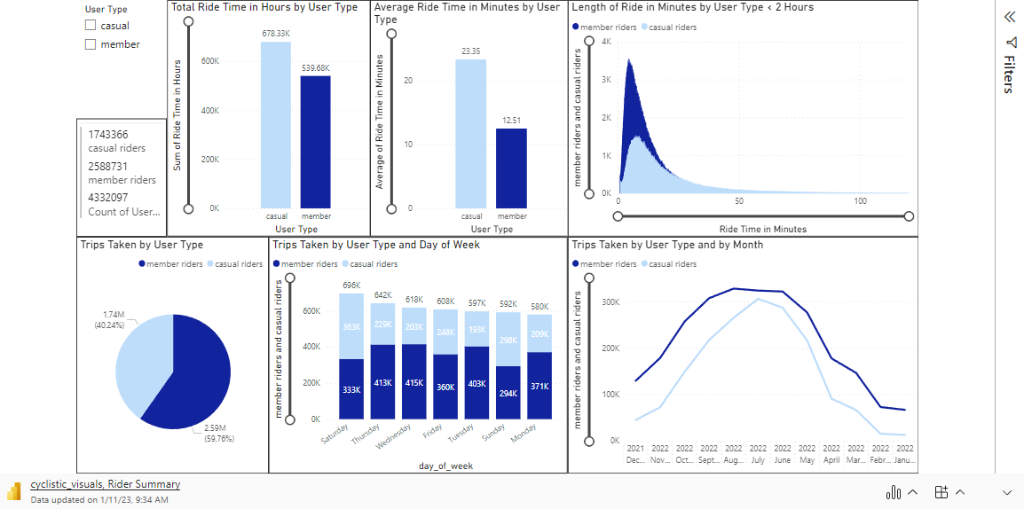
Microsoft Power BI, Rider Summary

Slide 10
Notable insights/findings:
The top 100 start stations are represented in the tree map
Streeter Dr and Grand Ave was the most popular station for casual riders (54,575 trips), which is close to the lakefront and Navy Pier
Kingsbury St and Kinzie St was the most popular station for members (23,581 trips), which is close to downtown offices/buildings
The heatmap shows the location of the stations when clicked on in the tree map (viewable via Power BI with an account)
Member riders do not use docked bikes

Slide 11
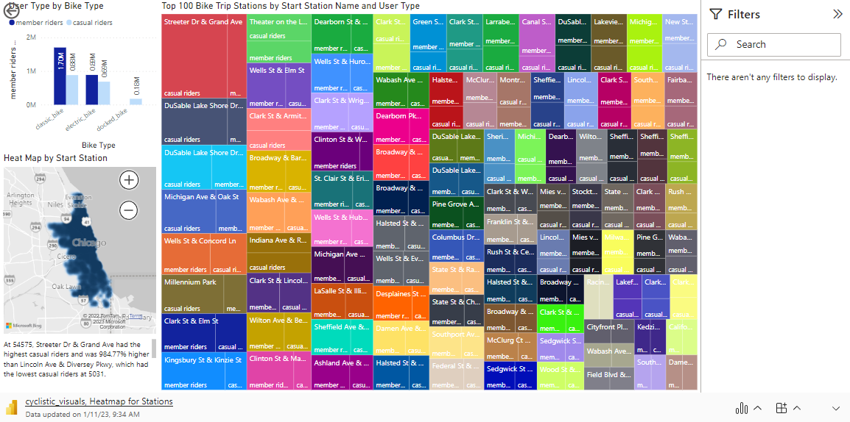
Microsoft Power BI, Heatmap and Station Popularity

Slide 12
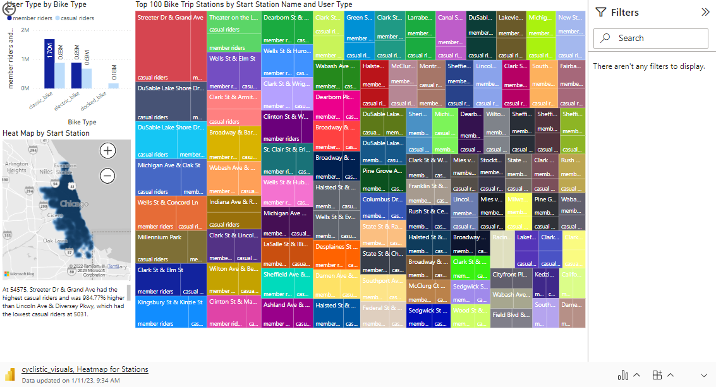

Slide 13
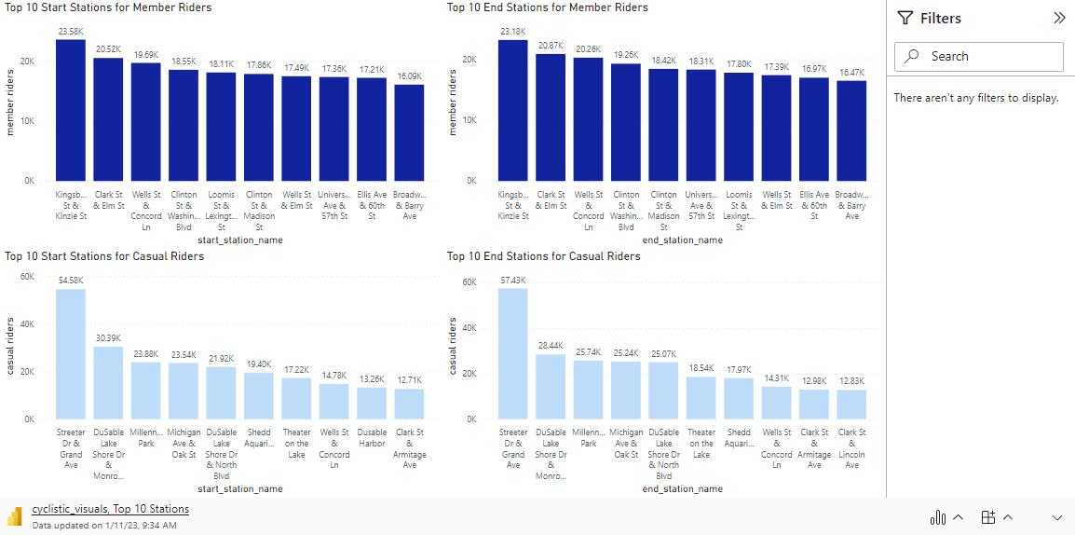
Microsoft Power BI, Top 10 Stations

Slide 14
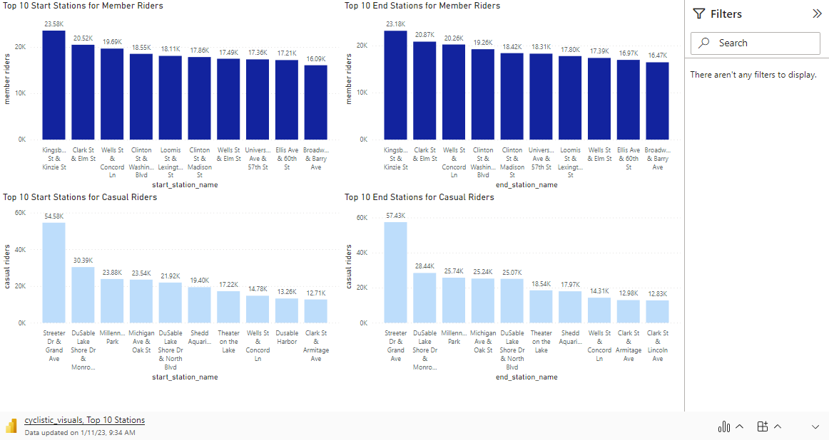

Slide 15
Notable insights/findings:
The interactive Stations Map represents the popularity of the lakefront, downtown, and tourist locations of Chicago
Many stations south of downtown Chicago are less frequently used, indicating that residential areas use the bike service less often

Slide 16
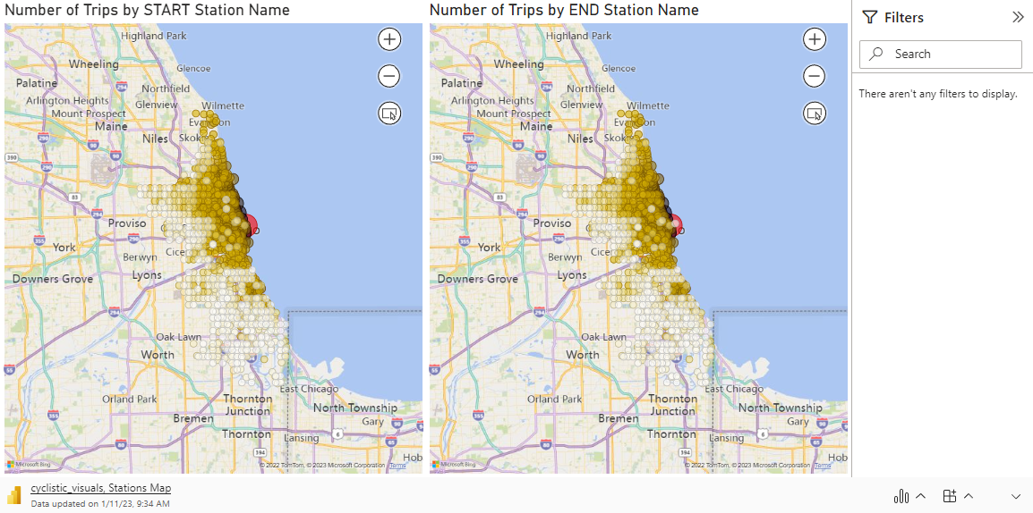
Microsoft Power BI, Stations Map

Slide 17
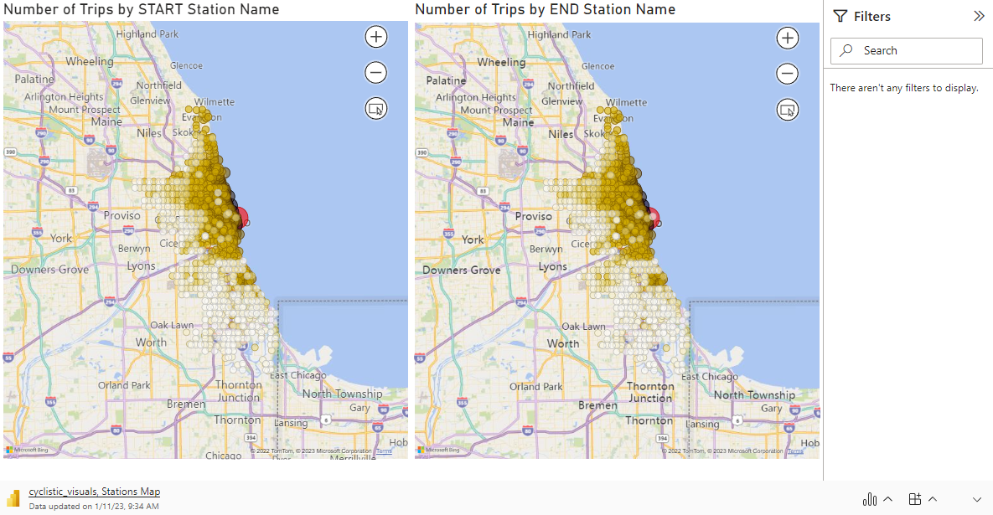

Slide 18
Notable insights/findings:
Members have two spikes during the day, a morning rush to work (7-9:30am) and evening rush after work (4-7:30pm)
Casual riders have a gradual daily spike peaking 3-7:30pm
60% of all users choose classic bikes for rides
36% of all users choose electric bikes for rides

Slide 19
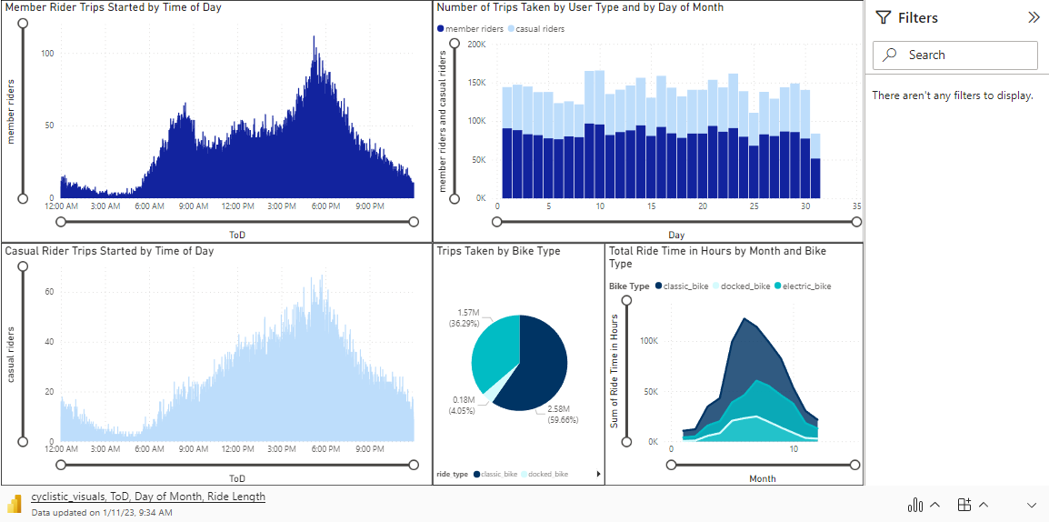
Microsoft Power BI, Time of Day/Month and Ride Length

Slide 20
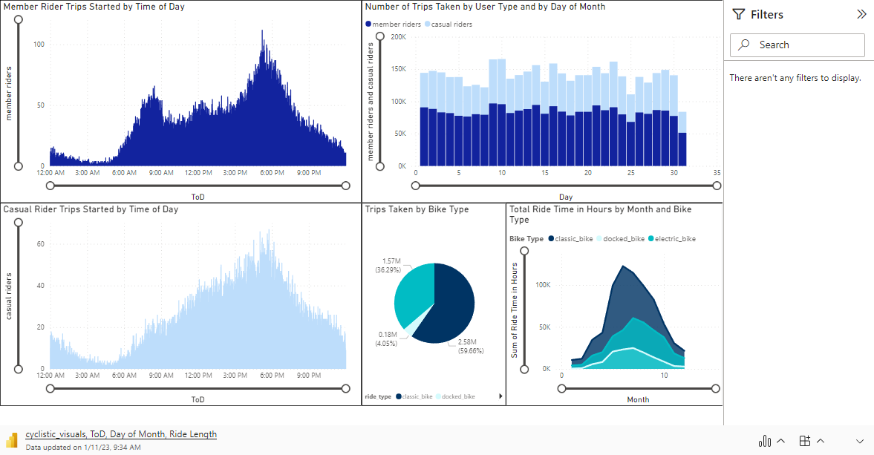

Slide 21
Conclusion
Members tend to use classic bikes for short work commutes, especially in the evening during the week, while casual riders mostly use bikes for longer rides of leisure on weekends
We don’t know the comparison of different types of bikes available, but classic bikes are used most frequently
Members use bikes more consistently throughout the year, while casual riders mostly use bikes during summer months

Slide 22
Recommendations
To encourage Cyclistic casual riders to become annual members:
Advertising should be placed near the lakefront and tourist areas of Chicago promoting annual membership and the cost savings associated, particularly during summer months on weekends between 3:00pm-7:30pm
Digital marketing should promote membership benefits of usage during the week for non-member work commuters and trips of leisure for casual riders not commuting to work
Offer membership trials/discounts/promotions for annual memberships during the winter months to increase usage
Increase the price of single-fare and full-day passes during the week in the evenings (between 3:00pm-7:30pm) and on the weekends to encourage casual riders to purchase annual memberships to save money (reverse financial incentive)

Slide 23
Appendix

Slide 24
clean_and_analyze_data
title: "Data Cleaning and Analysis"
author: "Jesse Richardville"
date: "2023-01-05"
output: html_document
---
# Document Summary
Clean and transform the merged Cyclistic data (all_data) file for analysis using R
​
Raw data has been collected by Motivate International Inc, the company operating Divvy - a bike share service across Chicago and Evanston. The license to use this public dataset can be found [here.](https://www.divvybikes.com/data-license-agreement)
​
## Upload the merged dataset from the working directory
```{r setup, include=FALSE}
library(readr)
all_bike_trip_merged <- read_csv("R docs/Working Directory/Cyclistic_case_study/data/raw/dirty_bike_data/all_bike_trip_merged.csv")
View(all_bike_trip_merged)
all_data <- all_bike_trip_merged
```
### Install appropriate packages
```{r setup, include=FALSE}
install.packages("tidyverse")
install.packages("lubridate")
install.packages("Magrittr")
library(tidyverse)
library(lubridate)
library(Magrittr)
# calculate ride length and add as a new column, ride_time
all_data$ride_time <- difftime(
all_data$ended_at,
all_data$started_at,
units = "secs"
)
# convert ride_time to hms for readability
library(data.table)
all_data <- all_data %>%
mutate(ride_hms = as.ITime(hms::hms(seconds_to_period(ride_time)))
)
# reposition columns in table for order
all_data <- all_data %>% relocate(ride_time, .after = ended_at)
all_data <- all_data %>% relocate(ride_hms, .after = ride_time)
# remove rides <60 seconds for outliers/not real rides
all_data <- arrange(all_data, -ride_time)
all_data <- arrange(all_data, ride_time)
all_data <- all_data %>%
filter(!(ride_time < 60)
)
# remove rides >12 hours (43200 seconds) for outliers/not real rides
all_data <- all_data %>%
filter(!(ride_time > 43200)
)
# remove rides missing data (without start_station_name or end_station_name)
all_data <- all_data %>%
filter(
!(is.na(start_station_name) |
start_station_name == "")
) %>%
filter(
!(is.na(end_station_name) |
end_station_name == "")
)
# check for abnormal station names - rides with ALL CAPS or all lower
UPPER_lower_station_name_check <- all_data %>%
filter(
str_detect(start_station_name, "[:upper:]")
& !str_detect(start_station_name,"[:lower:]")
) %>%
group_by(
start_station_name
) %>%
count(
start_station_name
)
# one station appeared 4 times with WEST CHI-WATSON, determined legitimate
# check for test data by star_station_name
library(stringr)
Test <- all_data[str_detect(all_data$start_station_name, "Test"), ]
all_data <- all_data %>%
filter(
!(str_detect(start_station_name, "Test"))
)
# removed 1 result containing "Test" in start_station_name
# check for duplicates
install.packages("janitor")
library(janitor)
duplicates <- get_dupes(all_data, ride_id)
#No variable names specified - using all columns.
# removed unnecessary column (1) from table
all_data <- all_data[, -c(1)]
# check for anomalies by running a summary of the dataset
install.packages("psych")
library(psych)
# create summary table
anomalies <- describe(all_data)
# no abnormalities, except there were 7 cases where the end_lat and end_lng
# were 0 but they had an end_station_name and end_station_id (were removed)
# check bike types and when they were available
unique(all_data$rideable_type)
[1] "classic_bike" "electric_bike" "docked_bike"
rideable_type_info <-all_data %>%
mutate(
year = year(started_at),
month = month(started_at)
) %>%
group_by(
month,
year
) %>%
select(
rideable_type,
member_casual,
month,
year
) %>%
count(
rideable_type,
member_casual
)
# After filtering the raw data, all data for docked_bike is for casual riders.
# Docked bikes are not used by member riders, but I'm not sure why.
# check station names for review
station_names <- all_data %>%
mutate(
year = year(started_at),
month = month(started_at)
) %>%
group_by(
month,
year
) %>%
select(
start_station_name,
month,
year
) %>%
count(start_station_name)
# create columns of data by 'day', 'day of week', 'month', and 'year' for future analysis/viz
# Day
all_data$day <- format(
all_data$started_at,
"%d"
)
# Day of week
all_data$day_of_week <- format(
all_data$started_at,
"%A"
)
# Month
all_data$month <- format(
all_data$started_at,
"%m"
)
# Year
all_data$year <- format(
all_data$started_at,
"%Y"
)
# Time of Day, HH:MM:SS
all_data$ToD <- format(
all_data$started_at,
"%H:%M:%S"
)
# statistical analysis by user type
summary(all_data$ride_time)
Min. 1st Qu. Median Mean 3rd Qu. Max.
60 376 649 1012 1156 43147
aggregate(all_data$ride_time ~ all_data$member_casual, FUN = mean)
all_data$member_casual all_data$ride_time
1 casual 1400.7239
2 member 750.5077
aggregate(all_data$ride_time ~ all_data$member_casual, FUN = median)
all_data$member_casual all_data$ride_time
1 casual 848
2 member 549
aggregate(all_data$ride_time ~ all_data$member_casual, FUN = max)
all_data$member_casual all_data$ride_time
1 casual 43147
2 member 43020
aggregate(all_data$ride_time ~ all_data$member_casual, FUN = min)
all_data$member_casual all_data$ride_time
1 casual 60
2 member 60
# create tables for visuals to be used in viz
# map tables for visual
map_viz_start <- all_data %>%
select(
start_station_name,
start_lat,
start_lng
) %>%
group_by(
start_station_name
) %>%
mutate(
numtrips = n()
) %>%
distinct(
start_station_name,
.keep_all = TRUE
)
map_viz_end <- all_data %>%
select(
end_station_name,
end_lat,
end_lng
) %>%
group_by(
end_station_name
) %>%
mutate(
numtrips = n()
) %>%
distinct(
end_station_name,
.keep_all = TRUE
)
```
title: "Data Cleaning and Analysis"
author: "Jesse Richardville"
date: "2023-01-05"
output: html_document
---
# Document Summary
Clean and transform the merged Cyclistic data (all_data) file for analysis using R
​
Raw data has been collected by Motivate International Inc, the company operating Divvy - a bike share service across Chicago and Evanston. The license to use this public dataset can be found [here.](https://www.divvybikes.com/data-license-agreement)
​
## Upload the merged dataset from the working directory
```{r setup, include=FALSE}
library(readr)
all_bike_trip_merged <- read_csv("R docs/Working Directory/Cyclistic_case_study/data/raw/dirty_bike_data/all_bike_trip_merged.csv")
View(all_bike_trip_merged)
all_data <- all_bike_trip_merged
```
### Install appropriate packages
```{r setup, include=FALSE}
install.packages("tidyverse")
install.packages("lubridate")
install.packages("Magrittr")
library(tidyverse)
library(lubridate)
library(Magrittr)
# calculate ride length and add as a new column, ride_time
all_data$ride_time <- difftime(
all_data$ended_at,
all_data$started_at,
units = "secs"
)
# convert ride_time to hms for readability
library(data.table)
all_data <- all_data %>%
mutate(ride_hms = as.ITime(hms::hms(seconds_to_period(ride_time)))
)
# reposition columns in table for order
all_data <- all_data %>% relocate(ride_time, .after = ended_at)
all_data <- all_data %>% relocate(ride_hms, .after = ride_time)
# remove rides <60 seconds for outliers/not real rides
all_data <- arrange(all_data, -ride_time)
all_data <- arrange(all_data, ride_time)
all_data <- all_data %>%
filter(!(ride_time < 60)
)
# remove rides >12 hours (43200 seconds) for outliers/not real rides
all_data <- all_data %>%
filter(!(ride_time > 43200)
)
# remove rides missing data (without start_station_name or end_station_name)
all_data <- all_data %>%
filter(
!(is.na(start_station_name) |
start_station_name == "")
) %>%
filter(
!(is.na(end_station_name) |
end_station_name == "")
)
# check for abnormal station names - rides with ALL CAPS or all lower
UPPER_lower_station_name_check <- all_data %>%
filter(
str_detect(start_station_name, "[:upper:]")
& !str_detect(start_station_name,"[:lower:]")
) %>%
group_by(
start_station_name
) %>%
count(
start_station_name
)
# one station appeared 4 times with WEST CHI-WATSON, determined legitimate
# check for test data by star_station_name
library(stringr)
Test <- all_data[str_detect(all_data$start_station_name, "Test"), ]
all_data <- all_data %>%
filter(
!(str_detect(start_station_name, "Test"))
)
# removed 1 result containing "Test" in start_station_name
# check for duplicates
install.packages("janitor")
library(janitor)
duplicates <- get_dupes(all_data, ride_id)
#No variable names specified - using all columns.
# removed unnecessary column (1) from table
all_data <- all_data[, -c(1)]
# check for anomalies by running a summary of the dataset
install.packages("psych")
library(psych)
# create summary table
anomalies <- describe(all_data)
# no abnormalities, except there were 7 cases where the end_lat and end_lng
# were 0 but they had an end_station_name and end_station_id (were removed)
# check bike types and when they were available
unique(all_data$rideable_type)
[1] "classic_bike" "electric_bike" "docked_bike"
rideable_type_info <-all_data %>%
mutate(
year = year(started_at),
month = month(started_at)
) %>%
group_by(
month,
year
) %>%
select(
rideable_type,
member_casual,
month,
year
) %>%
count(
rideable_type,
member_casual
)
# After filtering the raw data, all data for docked_bike is for casual riders.
# Docked bikes are not used by member riders, but I'm not sure why.
# check station names for review
station_names <- all_data %>%
mutate(
year = year(started_at),
month = month(started_at)
) %>%
group_by(
month,
year
) %>%
select(
start_station_name,
month,
year
) %>%
count(start_station_name)
# create columns of data by 'day', 'day of week', 'month', and 'year' for future analysis/viz
# Day
all_data$day <- format(
all_data$started_at,
"%d"
)
# Day of week
all_data$day_of_week <- format(
all_data$started_at,
"%A"
)
# Month
all_data$month <- format(
all_data$started_at,
"%m"
)
# Year
all_data$year <- format(
all_data$started_at,
"%Y"
)
# Time of Day, HH:MM:SS
all_data$ToD <- format(
all_data$started_at,
"%H:%M:%S"
)
# statistical analysis by user type
summary(all_data$ride_time)
Min. 1st Qu. Median Mean 3rd Qu. Max.
60 376 649 1012 1156 43147
aggregate(all_data$ride_time ~ all_data$member_casual, FUN = mean)
all_data$member_casual all_data$ride_time
1 casual 1400.7239
2 member 750.5077
aggregate(all_data$ride_time ~ all_data$member_casual, FUN = median)
all_data$member_casual all_data$ride_time
1 casual 848
2 member 549
aggregate(all_data$ride_time ~ all_data$member_casual, FUN = max)
all_data$member_casual all_data$ride_time
1 casual 43147
2 member 43020
aggregate(all_data$ride_time ~ all_data$member_casual, FUN = min)
all_data$member_casual all_data$ride_time
1 casual 60
2 member 60
# create tables for visuals to be used in viz
# map tables for visual
map_viz_start <- all_data %>%
select(
start_station_name,
start_lat,
start_lng
) %>%
group_by(
start_station_name
) %>%
mutate(
numtrips = n()
) %>%
distinct(
start_station_name,
.keep_all = TRUE
)
map_viz_end <- all_data %>%
select(
end_station_name,
end_lat,
end_lng
) %>%
group_by(
end_station_name
) %>%
mutate(
numtrips = n()
) %>%
distinct(
end_station_name,
.keep_all = TRUE
)
```

Slide 25
Ask
Guiding questions:
● What is the problem you are trying to solve?
● How can your insights drive business decisions?
Key tasks
1. How do annual members and casual riders use Cyclistic bikes differently?
2. Why would casual riders buy Cyclistic annual memberships?
3. How can Cyclistic use digital media to influence casual riders to become members
4. Consider the stakeholders
● Cyclistic: A bike-share program that features more than 5,800 bicycles and 600 docking stations. Cyclistic sets itself
apart by also offering reclining bikes, hand tricycles, and cargo bikes, making bike-share more inclusive to people with
disabilities and riders who can’t use a standard two-wheeled bike. The majority of riders opt for traditional bikes; about
8% of riders use the assistive options. Cyclistic users are more likely to ride for leisure, but about 30% use them to
commute to work each day.
● Lily Moreno: The director of marketing and your manager. Moreno is responsible for the development of campaigns
and initiatives to promote the bike-share program. These may include email, social media, and other channels.
● Cyclistic marketing analytics team: A team of data analysts who are responsible for collecting, analyzing, and
reporting data that helps guide Cyclistic marketing strategy. You joined this team six months ago and have been busy
learning about Cyclistic’s mission and business goals — as well as how you, as a junior data analyst, can help Cyclistic
achieve them.
● Cyclistic executive team: The notoriously detail-oriented executive team will decide whether to approve the
recommended marketing program
Deliverable
A clear statement of the business task:
Design marketing strategies aimed at converting casual riders into annual members based on three questions:
1. How do annual members and casual riders use Cyclistic bikes differently?
2. Why would casual riders buy Cyclistic annual memberships?
3. How can Cyclistic use digital media to influence casual riders to become members

Slide 26
Prepare
Guiding questions
● Where is your data located?
● How is the data organized?
● Are there issues with bias or credibility in this data? Does your data ROCCC?
● How are you addressing licensing, privacy, security, and accessibility?
● How did you verify the data’s integrity?
● How does it help you answer your question?
● Are there any problems with the data?
Key tasks
1. Download data and store it appropriately.
C:\Users\jesse\OneDrive\Documents\R docs\Working Directory\Cyclistic_case_study\data\raw\dirty_bike_data
2. Identify how it’s organized.
merged using R
3. Sort and filter the data.
cleaned/manipulated and analyzed using R
4. Determine the credibility of the data.
data is open source directly from the company (https://divvy-tripdata.s3.amazonaws.com/index.html)
data has been made available by Motivate International Inc. under this license: (https://ride.divvybikes.com/data-license-agreement)
data is credible and has integrity - it is valid, complete, up to date, accurate and consistent (after transforming in R).
Deliverable
Obtain and import data for cleaning, formatting, and transformation:
1. Data is complete, original, and open source, directly from the company (https://divvy-tripdata.s3.amazonaws.com/index.html) and has been made available by Motivate International Inc. under this license (https://ride.divvybikes.com/data-license-agreement). I have chosen to analyze 12 months of data from 12/2021 - 11/2022, which was last updated on Dec 8th 2021, 02:19:04 pm.
2. Download data and store it appropriately.
C:\Users\jesse\OneDrive\Documents\R docs\Working Directory\Cyclistic_case_study\data\raw\dirty_bike_data
3. Merge, sort, filter, format, and transform the data using R for analysis and document this process.

Slide 27
Process
Guiding questions
● What tools are you choosing and why?
● Have you ensured your data’s integrity?
● What steps have you taken to ensure that your data is clean?
● How can you verify that your data is clean and ready to analyze?
● Have you documented your cleaning process so you can review and share those results?
Key tasks
1. Check the data for errors.
used R for cleaning
2. Choose your tools.
R for cleaning/manipulation/analysis, power BI for visualizations
3. Transform the data so you can work with it effectively.
transformed using R
4. Document the cleaning process.
kept a changelog with steps of analysis
Deliverable
data log (Data log cert project 1)
C:\Users\jesse\OneDrive\Desktop\Portfolio Projects\Bike Share Project\documents
Document the cleaning and manipulation of data:
1. R-Studio Desktop was used for data cleaning and transformation.
2. .Rmd files are included for the processing steps.

Slide 28
Analyze
Guiding questions
● How should you organize your data to perform analysis on it?
● Has your data been properly formatted?
● What surprises did you discover in the data?
● What trends or relationships did you find in the data?
● How will these insights help answer your business questions?
Key tasks
1. Aggregate your data so it’s useful and accessible.
formatted in R, new columns created for relevant data
2. Organize and format your data.
sorted, organized the dataframe/table in R
3. Perform calculations.
manipulated in R, imported into Power BI, further transformed with Power Query for analysis
4. Identify trends and relationships.
created visuals using Power BI, created dashboard
Deliverable
A summary of your analysis
Organize data for analysis and to create visuals:
1. Run statistical analysis and add formatted columns to dataset for new variables to use for visualizations.
2. Import data to Power BI to identify trends and relationships, and to use for visualizations.

Slide 29
Share
Guiding questions
● Were you able to answer the question of how annual members and casual riders use Cyclistic bikes differently?
● What story does your data tell?
● How do your findings relate to your original question?
● Who is your audience? What is the best way to communicate with them?
● Can data visualization help you share your findings?
● Is your presentation accessible to your audience?
Key tasks
1. Determine the best way to share your findings.
Power BI
2. Create effective data visualizations.
main focus was comparing user type (member vs. casual, across different criteria)
3. Present your findings.
present using github via powerpoint presentation (for power BI visuals embedded)
4. Ensure your work is accessible.
published report to make the project available for others
Deliverable
Supporting visualizations and key findings
used Power BI
C:\Users\jesse\OneDrive\Documents\R docs\Working Directory\Cyclistic_case_study\data_output
Create visuals and a presentation (consider original questions and audience/stakeholders):
1. Use Power BI for visuals (since it is often referenced in job descriptions).
2. Publish Power BI dashboard for presentation.
3. Create presentation using Powerpoint (for interactive/live Power BI embed).

Slide 30
Act
Guiding questions
● What is your final conclusion based on your analysis?
● How could your team and business apply your insights?
● What next steps would you or your stakeholders take based on your findings?
● Is there additional data you could use to expand on your findings?
Key tasks
1. Create your portfolio.
2. Add your case study.
3. Practice presenting your case study to a friend or family member.
Deliverable
Notable insights/findings:
1. Members take 60% of the rides
2. Wednesday is the most popular day for members, Saturday is the most popular day for casual riders, Saturday is the most popular overall (16% of all rides taken).
3. Casual riders take longer rides by time (23.3 min avg ride), members take shorter rides (12.5 min avg ride).
Compared to members, who take shorter journeys (13 minutes on average), casual riders prefer to take longer rides (23 minutes on average). Casual riders joining w/a subscription could result in financial savings, rather than paying for trips based on trip length by time.
4. Streeter Dr and Grand Ave is the most popular station (close to the lakefront and Navy Pier), Kingsbury St and Kinzie St is most pop for members
5. Members have two spikes during the day, a morning rush to work (7-9:30am) and evening rush after work (4-7:30pm).
6. Casual riders have a gradual daily spike peaking 3-7:30pm.
Present findings and give top three recommendations:
1. Determine how to apply insights
2. Determine next steps based on findings (consider pros and cons and if more data is needed)
3. Add case study to portfolio
Recommendations based on analysis
To encourage Cyclistic casual riders to become annual members:
1. Advertising should be placed near the lakefront and tourist areas of Chicago promoting annual membership and the cost savings associated, particularly during summer months on weekends between 3:00pm-7:30pm
2. Digital marketing should promote membership benefits of usage during the week for non-member work commuters and trips of leisure for casual riders not commuting to work
3. Offer membership trials/discounts/promotions for annual memberships during the winter months to increase usage
4. Increase the price of single-fare and full-day passes during the week in the evenings (between 3:00pm-7:30pm) and on the weekends to encourage casual riders to purchase annual memberships to save money (reverse financial incentive)

